Slide 1
Predicting Noisy Images
Using KNN classifier
submmited by
nivetha vinayagamoorthy
Batch: 6263

Slide 2
About this Project
In this project we will be using the MNIST dataset. First, we will add noise to the images in the MNIST dataset, then we will train a KNN Classifier on this noisy dataset so that it can predict the corresponding non-noisy image from it's noisy counterpart.
In this project we will discuss how to predict images from their noisy version.

Slide 3
MNIST DATASET
The MNIST database (Modified National Institute of Standards and Technology database) is a large database of handwritten digits that is commonly used for training various image processing systems. The database is also widely used for training and testing in the field of machine learning.

Slide 4
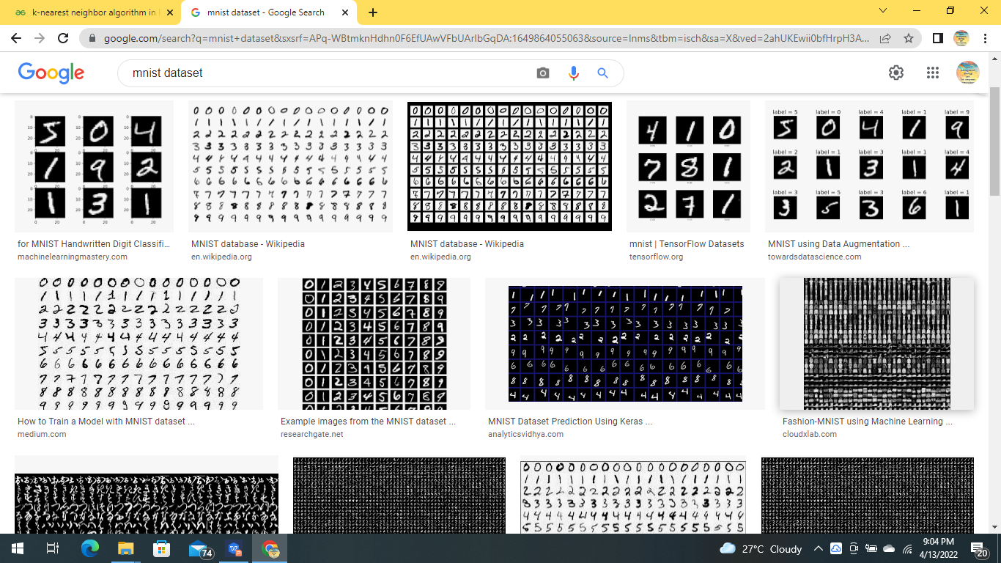
MNIST dataset example

Slide 5
noisy image
Image noise is random variation of brightness or color information in images, and is usually an aspect of electronic noise. It can be produced by the image sensor and circuitry of a scanner or digital camera.

Slide 6
Import Libraries
In this first step, we would import all the libraries required for this project.
numpy
pandas
gzip
matplotlib

Slide 7
Define the Function to Show Images
In this step, we will define a function named showImage() that will help us view the images in the dataset.

Slide 8
Load the Data
In this step we will load the dataset, and then store it into train and test sets. The dataset consists of 4 files:
These files are located at the following path:
/cxldata/datasets/project/mnist/
Finally, we will store them in 4 variables:
X_train, y_train, X_test, y_test

Slide 9
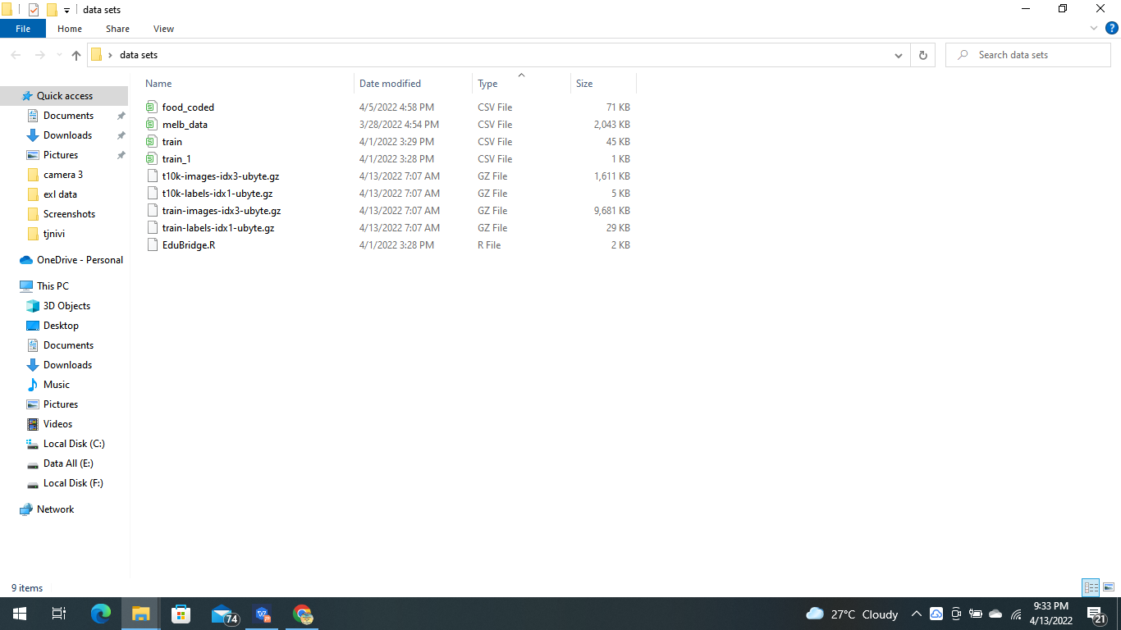
Provide the path to the files:
Open the Gzip files:
Store the data into the 4 variables

Slide 10
Explore the Data
In this step we will explore the dataset.
First, we will print the shape of the variables we created in the previous step
Next, we will use the showImage() function we created earlier to view the first image in the training set and it's corresponding label:

Slide 11
Finally, we will view few more images from the dataset
We define the random seed:
Now we shuffle the training data:

Slide 12
Add Noise to the Data
In this step, we will add noise to the images. We would use the randint function to generate the noise and then add the noise to the train and test set. Finally, we would store this noisy data in 2 new variables
called X_train_mod
and X_test_mod.
Import random module as rnd

Slide 13
Generate the noise and store the noisy data into the new variables:
using the randint() function. The randint() function takes 4 inputs:
low
high
size
datatype

Slide 14
View the Noisy Data
Use the showImage() function we created earlier to view the noisy images and it's corresponding image without the noise:

Slide 15
Train a KNN Classifier
In this step, we will train a KNN Classifier on the noisy images so that it can predict the non-noisy image from the same.

Slide 16
Predict Noisy Image
Predict any noisy image using the model we created:
Now show the corresponding image:
showImage(clean_digit)
Now let's see the original image:
showImage(y_test_mod[5000])

Slide 17
coding
import numpy as np
import pandas as pd
import gzip
%matplotlib inline
import matplotlib
import matplotlib.pyplot as plt
def showImage(data):
some_article = data # Selecting the image.
some_article_image = some_article.reshape(28, 28) #Reshaping it to get the 28x28 pixels

Slide 18
plt.imshow(some_article_image, cmap = matplotlib.cm.binary, interpolation="nearest")plt.axis("off")
plt.show()filePath_train_set = r'C:\Users\nivetha\Desktop\data sets\train-images-idx3-ubyte.gz'
filePath_train_label = r'C:\Users\nivetha\Desktop\data sets\train-labels-idx1-ubyte.gz'
filePath_test_set = r'C:\Users\nivetha\Desktop\data sets\t10k-images-idx3-ubyte.gz'
filePath_test_label = r'C:\Users\nivetha\Desktop\data sets\t10k-labels-idx1-ubyte.gz'

Slide 19
with gzip.open(filePath_train_label, 'rb') as trainLbpath:
trainLabel = np.frombuffer(trainLbpath.read(), dtype=np.uint8,offset=8)
with gzip.open(filePath_train_set, 'rb') as trainSetpath:
trainSet = np.frombuffer(trainSetpath.read(), dtype=np.uint8,offset=16).reshape(len(trainLabel), 784)

Slide 20
with gzip.open(filePath_test_label, 'rb') as testLbpath:
testLabel = np.frombuffer(testLbpath.read(), dtype=np.uint8,offset=8)
with gzip.open(filePath_test_set, 'rb') as testSetpath:
testSet = np.frombuffer(testSetpath.read(), dtype=np.uint8,offset=16).reshape(len(testLabel), 784)

Slide 21
X_train, X_test, y_train, y_test = trainSet, testSet, trainLabel, testLabel
print(X_train.shape)
print(y_train.shape)
print(X_test.shape)
print(y_test.shape)
showImage(X_train[0])
y_train[0]

Slide 22
plt.figure(figsize=(10,10))
for i in range(15):
plt.subplot(5,5,i+1)
plt.xticks([])
plt.yticks([])
array_image = X_train[i].reshape(28, 28)
plt.imshow(array_image, cmap = matplotlib.cm.binary, interpolation="nearest")
plt.show()

Slide 23
np.random.seed(42)
shuffle_index = np.random.permutation(60000)
X_train, y_train = X_train[shuffle_index], y_train[shuffle_index]
import numpy.random as rnd
noise_train = rnd.randint(0, 100, (len(X_train), 784))
X_train_mod = X_train + noise_train
noise_test = rnd.randint(0, 100, (len(X_test), 784))
X_test_mod = X_test + noise_test
y_train_mod = X_train
y_test_mod = X_test

Slide 24
showImage(X_test_mod[4000])
showImage(y_test_mod[4000])
from sklearn.neighbors import KNeighborsClassifier
knn_clf = KNeighborsClassifier()
knn_clf.fit(X_train_mod, y_train_mod)
clean_digit = knn_clf.predict([X_test_mod[4000]])

Slide 25
showImage(clean_digit)
showImage(y_test_mod[5000])

Slide 26
output
(60000, 784)
(60000,)
(10000, 784)
(10000,)

Slide 27
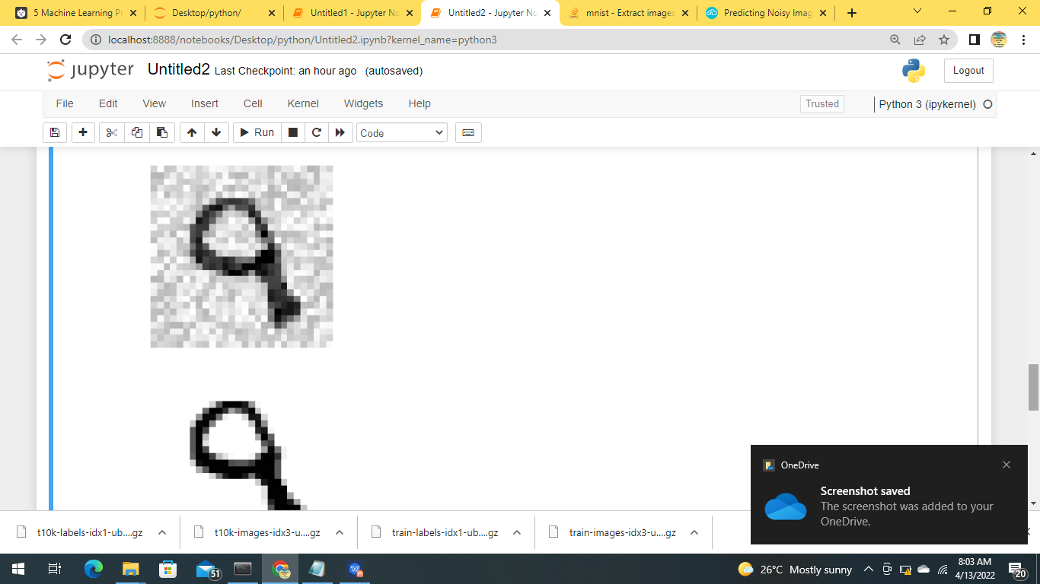
sample outputs

Slide 28
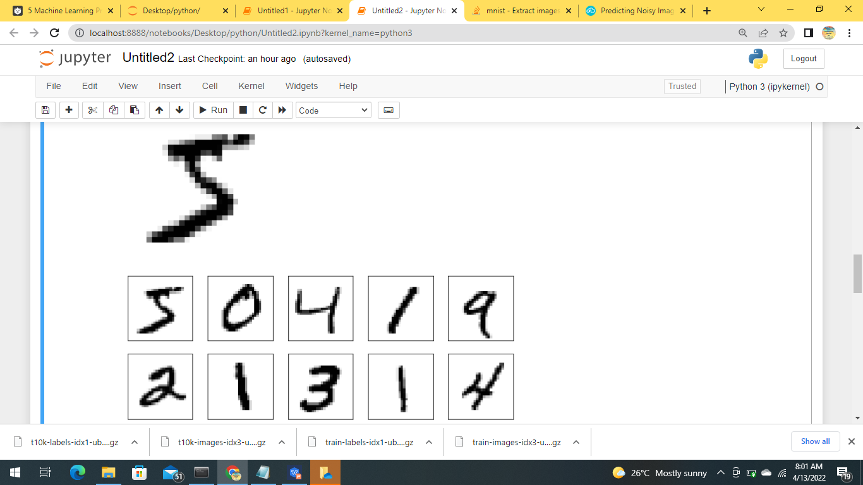

Slide 29
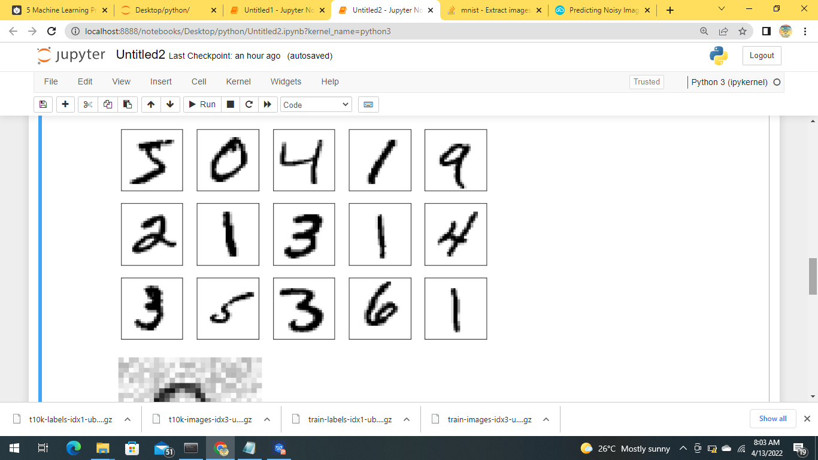

Slide 30
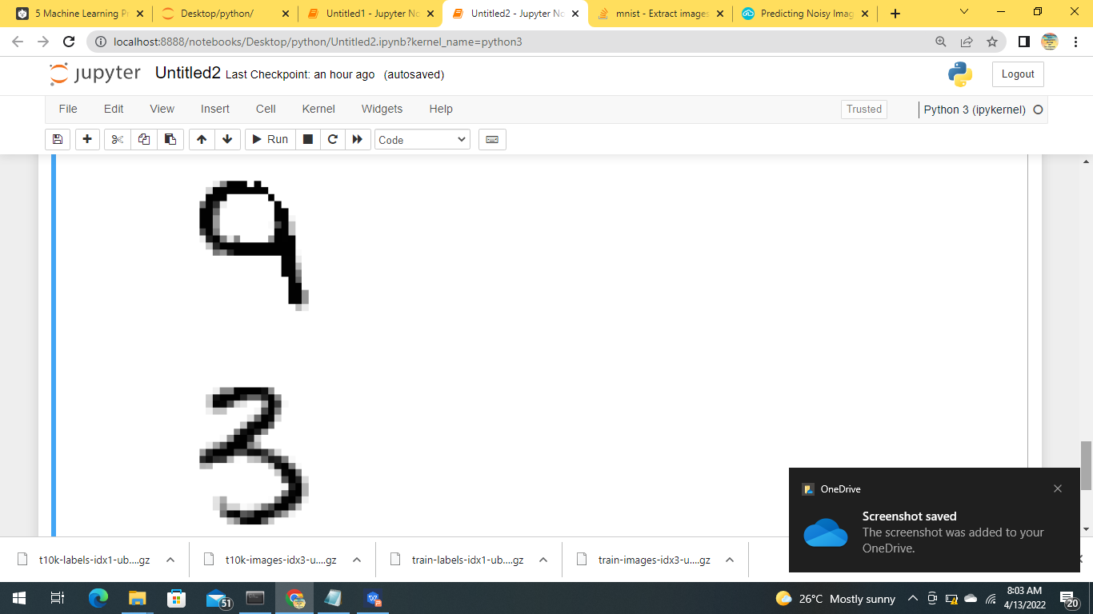

Slide 31
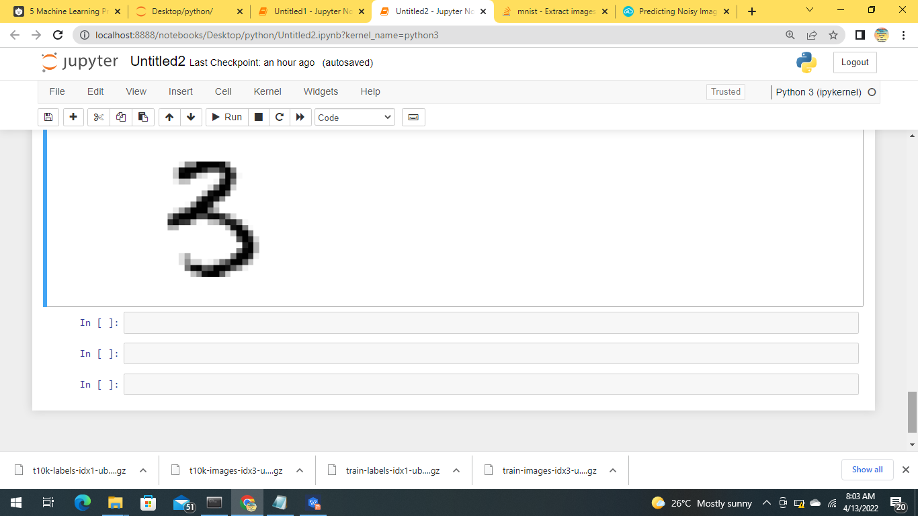

Slide 32
QUESTION AND ANSWER SECTION

Slide 33
Thank you!

